Slide 1
Alamos gold
W. Pieters, Q. Nijs 2025-2026

Slide 2
Macro & Industry

Slide 3
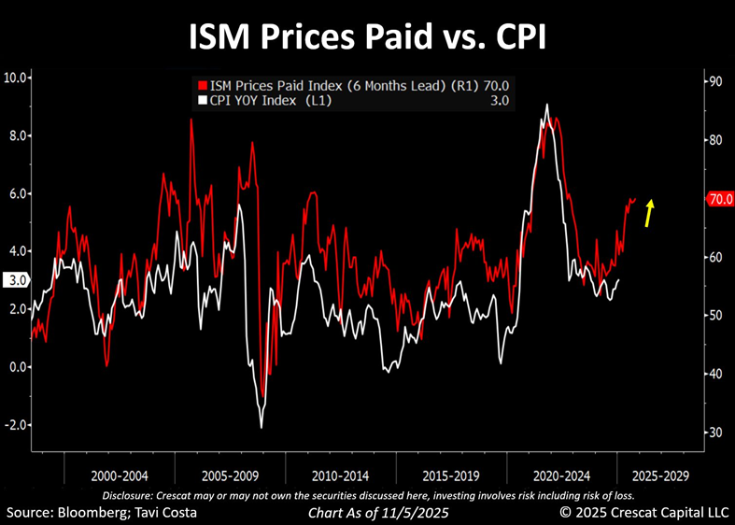

Inflation & Interest Rates

Slide 4
Inflation & Interest Rates
VIC Macro van vandaag
  Spending bill
  Dividend tarrif
  => inflationair?

Slide 5
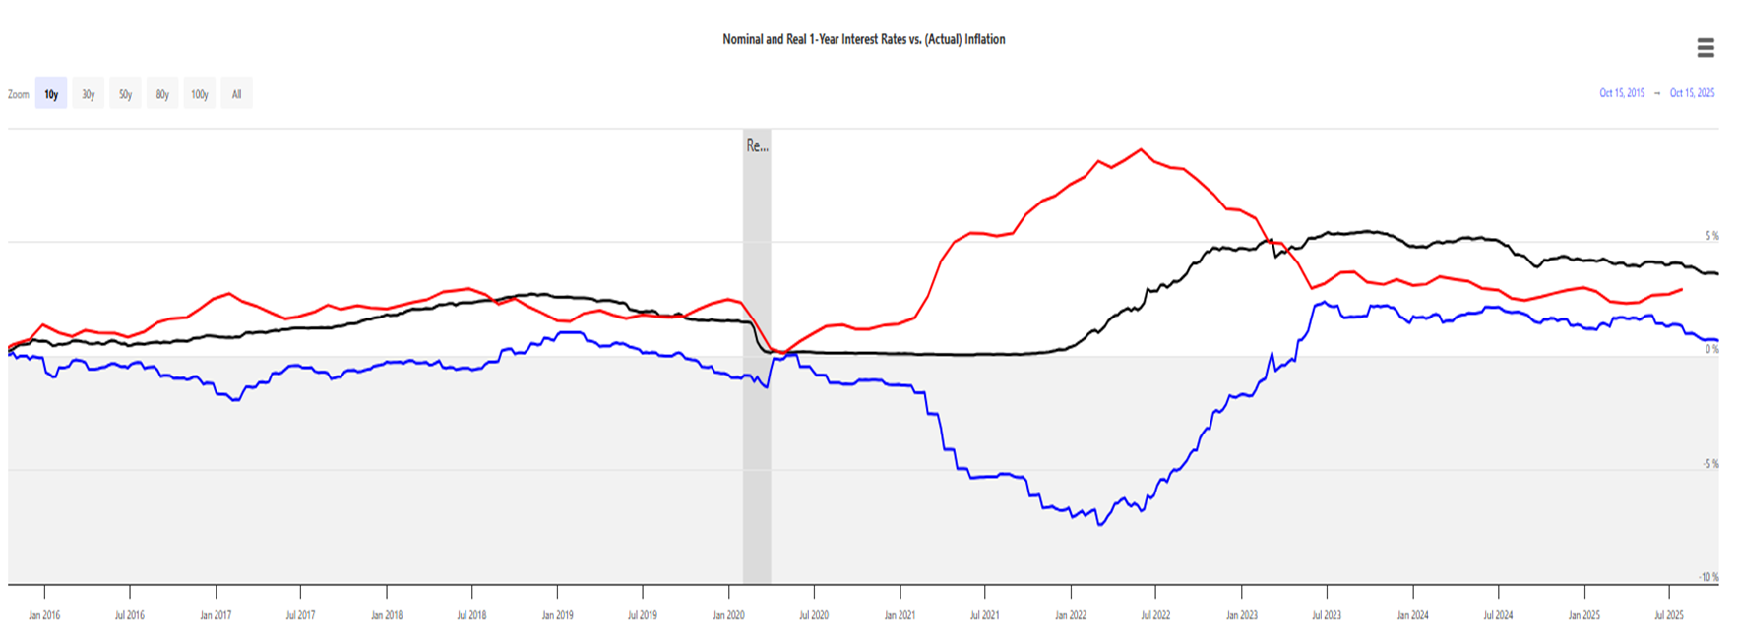
Real Interest Rate

Slide 6
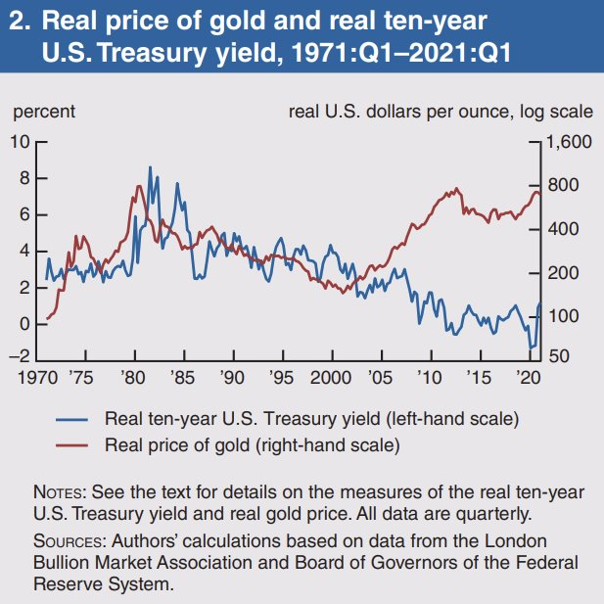
Real Interest Rate

Slide 7
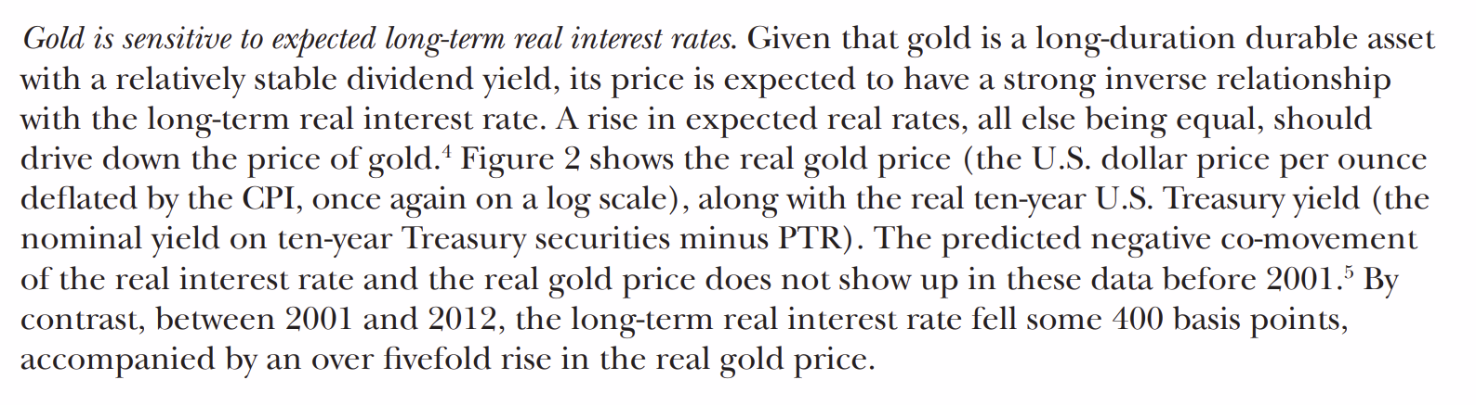
Real Interest Rate

Slide 8
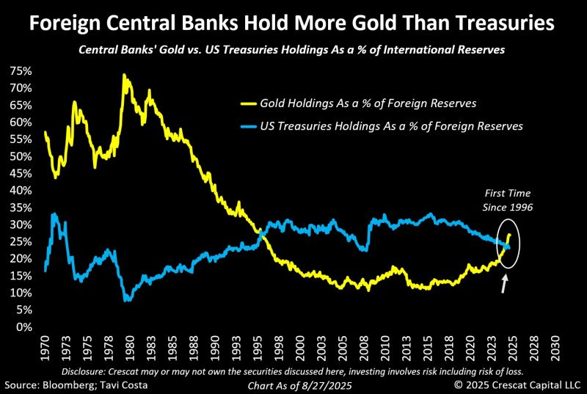
Foreign Central Bank Holdings

Slide 9
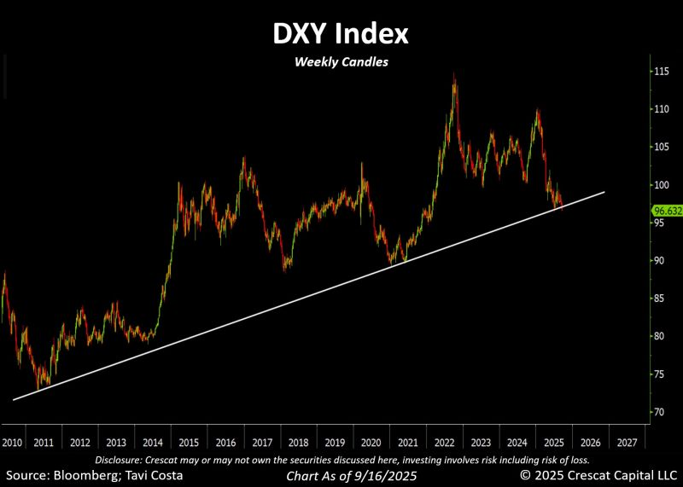
Dollar

Slide 10
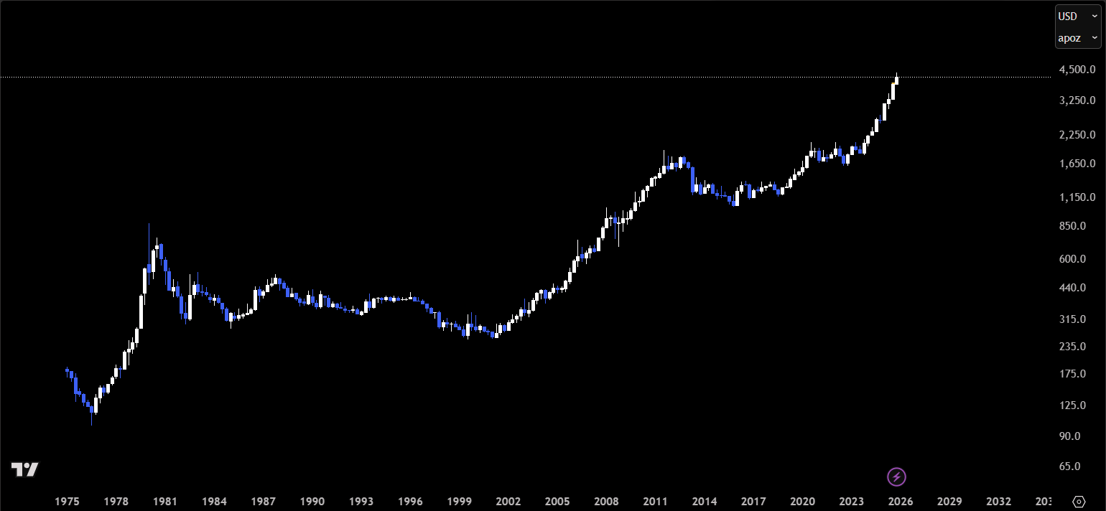
Gold Price

Slide 11
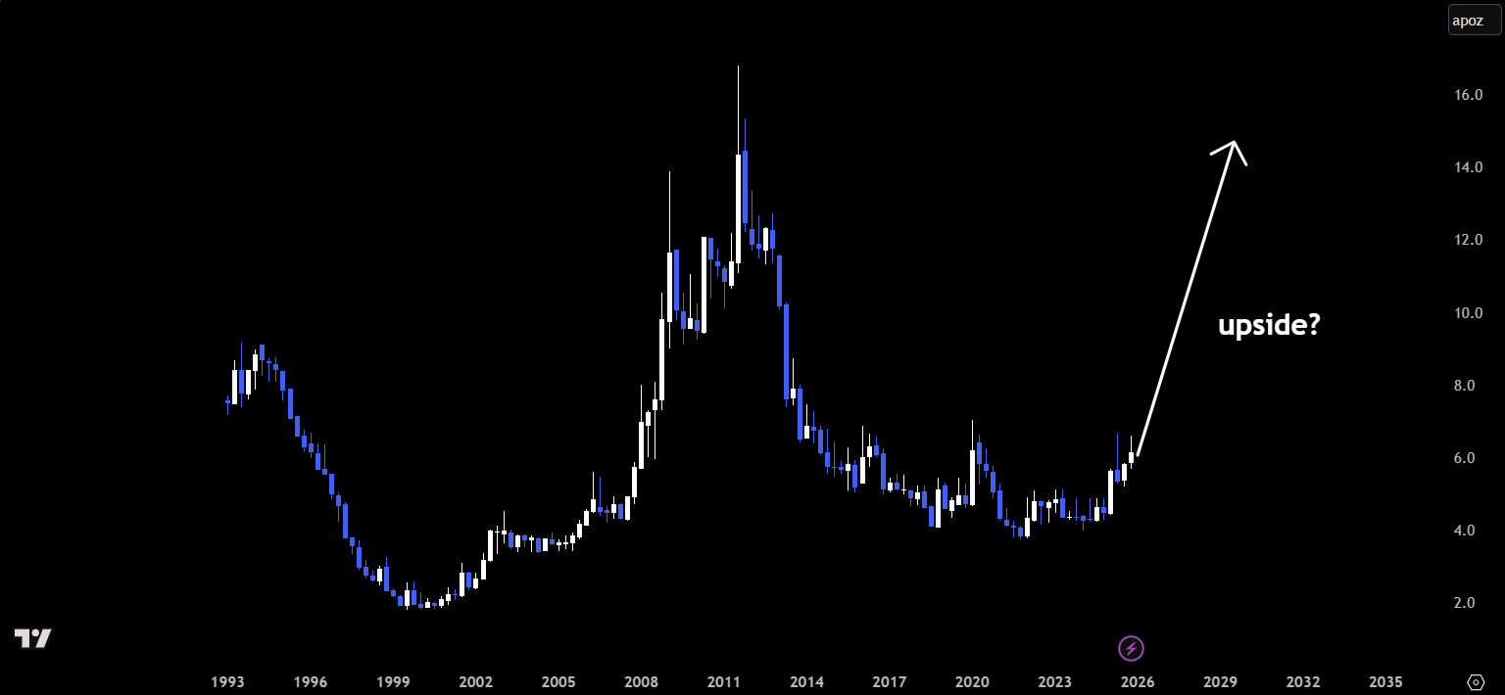
Ratio Gold Price to SPY

Slide 12
Additional
Geopolitical tensions
Long-term trend of
  Foreign central banks => de-dollarizing
U.S. => wants to fix trade deficit

Slide 13
Company-Specific

Slide 14
Overview
Mid-tier Canadian gold producer
Founded 2003 via Alamos Minerals × National Gold merger
HQ Toronto | Mines in Canada and Mexico
Long-term production goal ≈ 900 k oz gold / yr
  (2024: 567k oz)

Slide 15
History
2003 – Mulatos deposit acquired (Sonora, MX)
2015 – Merged with AuRico Gold
2017 – Acquired Richmont Mines
Track record of acquisitions + organic development

Slide 16
Management
CEO & Co-Founder: John McCluskey (since 2003)
  Serves as a Director of the World Gold Council.
  2023 Viola R. MacMillan Award: Recognized for leadership in developing the Island Gold mine. 2018 Murray Pezim Award: Honored for financing and exploration success at Mulatos. 2012 EY Entrepreneur of the Year: Awarded for vision, leadership, and entrepreneurial spirit.
CFO: Greg Fisher (joined in 2010; CFO since 2023)
  Alternate Director of the World Gold Council.
  Nearly 20 years of mining experience, including as a Senior Manager at KPMG.
COO: Luc Guimond (since 2022)
  Earlier roles include Project Manager at Northgate Minerals and senior positions at Noranda, Hemlo Gold, Battle Mountain Gold, and Newmont.
  Bachelor of Applied Science in Mining Engineering from Queen’s University; graduate of Haileybury School of Mines; licensed Professional Engineer in Ontario.

Slide 17
Hedging
Current Hedge Position
  ~150,000 oz hedged in total: 100 k oz (2026) + 50 k oz (2027)
  Fixed forward price ≈ US $1,821 / oz
Unhedged Exposure
  2025 production guidance: ≈ 575 k oz
  < 15 % of annual production hedged → ≈ 85–90 % fully exposed to spot gold
Implications
  High leverage to gold price movements
  Strategy shift since 2024 to unwind hedge book and maximize exposure to higher prices

Slide 18
Main Activities
Operates three producing gold mines
Engages in exploration for new gold deposits and the expansion of existing ones (near-mine and regional programmes)
Develops growth projects (including major expansions of existing mines and development of new mines) to increase gold production and extend mine life.
Seeks strategic acquisitions to add assets and scale.

Slide 19
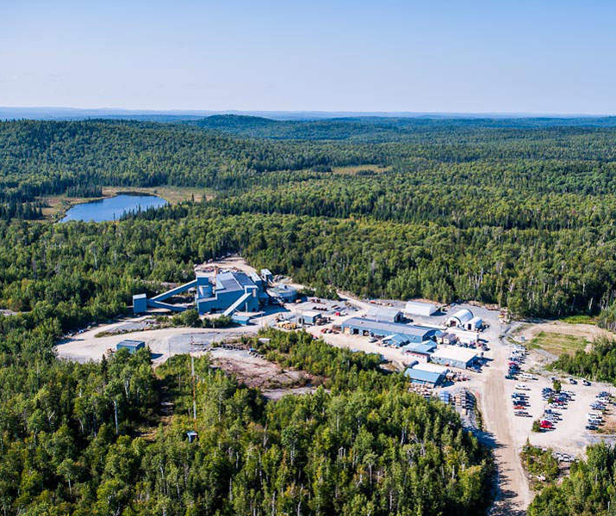
Actual
Northern Ontario (Canada):
Island Gold/Magino District
  Underground & open pit mines
  High grade
  20+ years to go
Notes:
Its producing operations are mostly in North America, specifically:
Canada: Northern Ontario (the “Island Gold District”, which includes the Island Gold Mine underground operation and now also the nearby Magino Mine open pit via acquisition). Canada: Also the Young‑Davidson Mine in northern Ontario.
Mexico: The Mulatos Mine district in Sonora State (and also the satellite “La Yaqui Grande” within that district) are part of their portfolio.
Growth/development projects also include:
The Lynn Lake Project in Manitoba, Canada.
Expansion of the Island Gold/Magino district (Phase 3+).
Strategic importance: Canada is a low-political-risk jurisdiction; the asset base in Canada supports a strong “safe jurisdiction” narrative.
Reserve growth: The 2024 Reserves and Resources report points to Island Gold as a key driver of reserve growth (reserves increased 32% to 2.3 million oz at Island Gold).

Slide 20
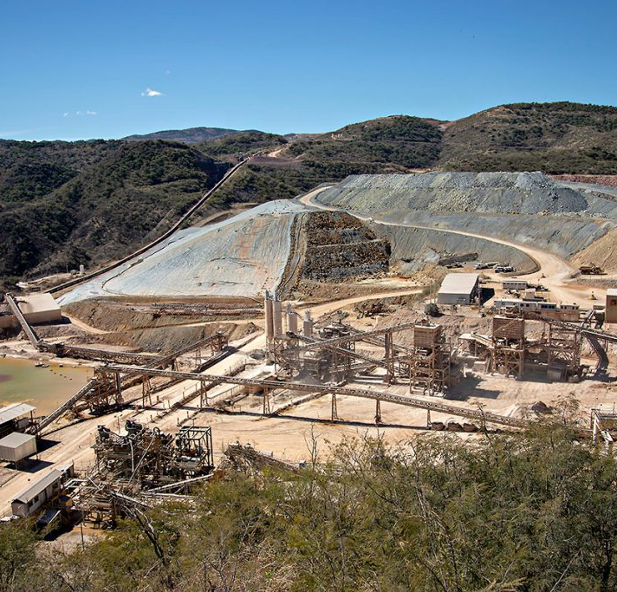
Actual
Mulatos District (Sonora, Mexico):
Mulatos Mine (open pit & mill)
La Yaqui Grande (satellite depo.)
Notes:
The Mulatos Mine has been a long-established asset for Alamos (open pit heap leach + mill).
It, along with La Yaqui Grande (satellite deposit), forms the Mulatos District.
While solid, compared to the Island Gold/Magino combination, this asset appears less “strategic growth driver” (though still important).

Slide 21
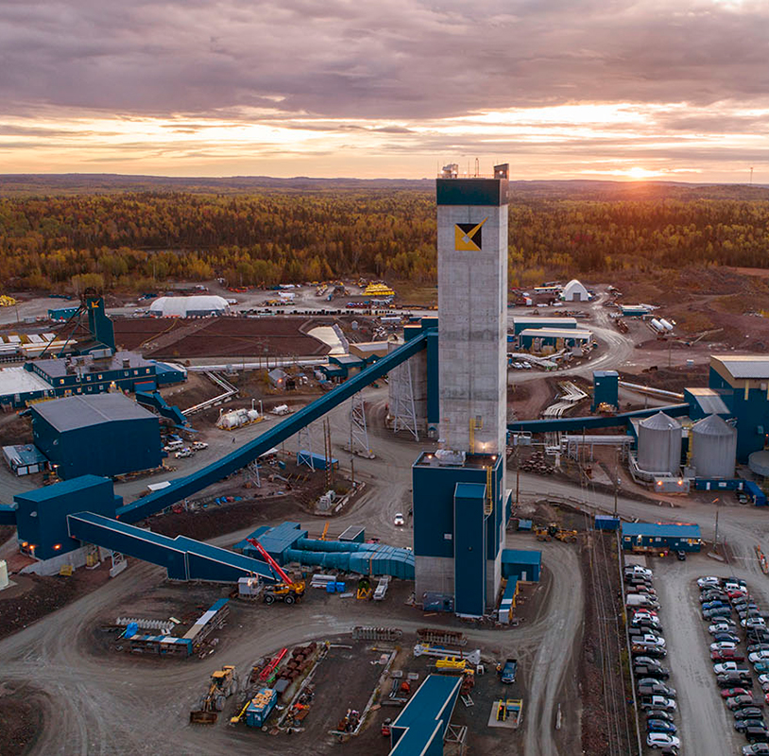
Actual
Young Davidson Mine (Canada):
Notes:
A major Canadian underground mine with established production.
It supports Alamos’s Canadian production base but again appears less head-liner compared to Island Gold/Magino.

Slide 22
Projects
Operating Mines
  Island Gold (ON, CA) – High-grade underground mine
    Phase 3+ expansion: on time: reducing costs
  Young-Davidson (ON, CA) – Large underground, stable output
  Mulatos (MX) – Flagship open-pit, heap-leach operation
  Combined output ≈ 500–600 k oz/yr
Growth Pipeline
  Lynn Lake (MB, CA) – Next development phase (2026–27 target)
  Quartz Mountain (US) – Early stage permitting
  Turkish projects – Licensing disputes paused operations

Slide 23
Financials
Year | 2023 |  |  |  | 2024 |  |  |  | 2025
Quarter | Q1 | Q2 | Q3 | Q4 | Q1 | Q2 | Q3 | Q4 | Q1 | Q2 | Q3
EPS Reported | 0,12 | 0,15 | 0,14 | 0,12 | 0,13 | 0,24 | 0,19 | 0,25 | 0,14 | 0,34 | 0,37
EPS Growth YoY |  |  |  |  | 8% | 60% | 36% | 108% | 8% | 42% | 95%
Revenue Reported | 252 | 261 | 256 | 255 | 278 | 333 | 361 | 376 | 333 | 438 | 462
Revenue Growth YoY |  |  |  |  | 10% | 27% | 41% | 48% | 20% | 32% | 28%
Margin | 19% | 29% | 15% | 19% | 15% | 21% | 23% | 23% | 5% | 36% | 60%
Margin improvement |  |  |  |  | -4pp | -8pp | 8pp | 5pp | -11pp | 15pp | 36pp

Slide 24
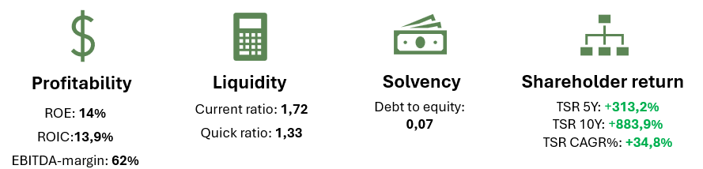
Financials
Profitability
ROE: 14%
ROIC:13,9%
EBITDA-margin: 62%
Liquidity
Current ratio: 1,72
Quick ratio: 1,33
Solvency
Debt to equity: 0,07
Shareholder return
TSR 5Y: +313,2%
TSR 10Y: +883,9%
TSR CAGR%: +34,8%

Slide 25
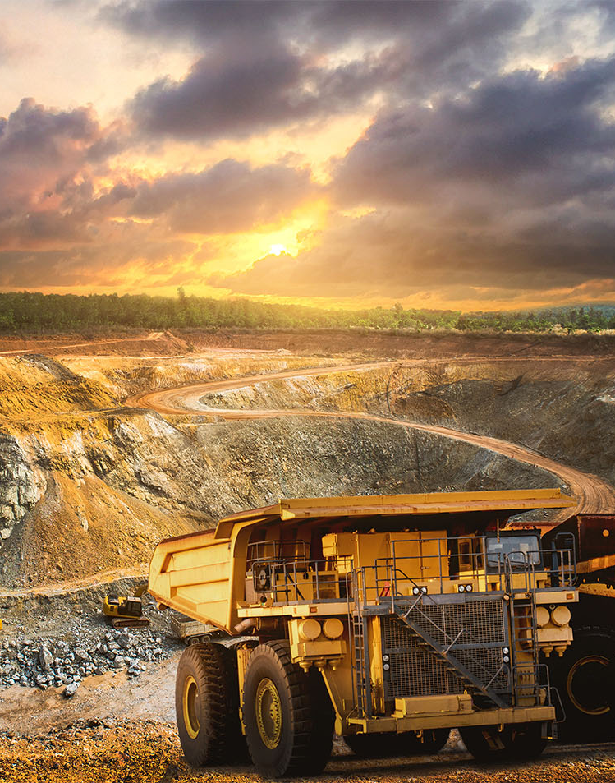
Peers
Agnico Eagle Mines
Mature, top-quality assets, yet limited organic growth => less stability and yield
Kinross Gold
Geographic diversification but higher political risk (Mauritania, Chile, Brazil)
Newmont Corp
Dominates globally, yet behaves like a dividend utility now
Huge production
Slower growth
Exposed to cost inflation and complex jurisdictions.
If gold keeps rising => AGI most upside

Slide 26
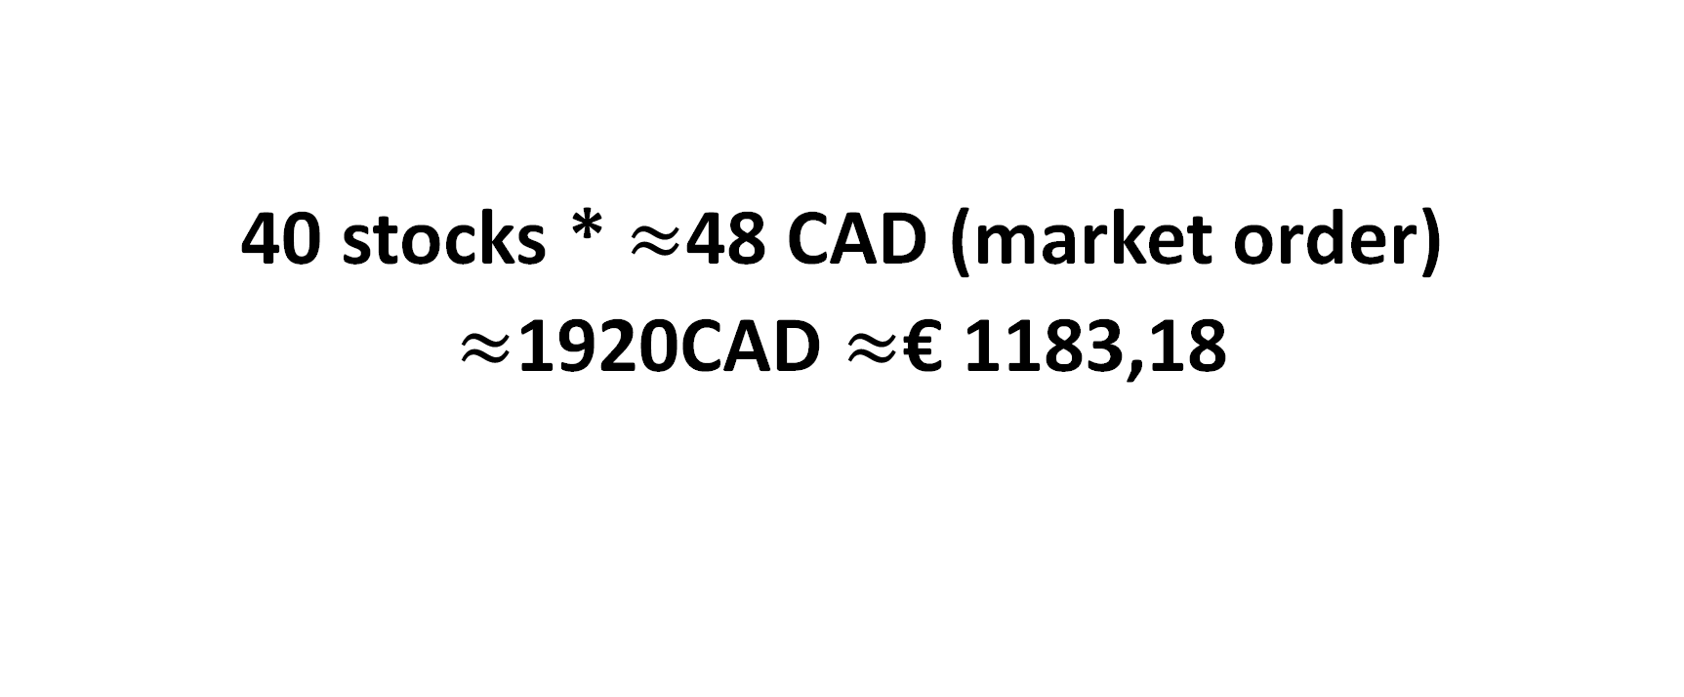
Voorstel
40 stocks * $≈$48 CAD (market order)
$≈$1920CAD $≈$€ 1183,18

